Slide 1
Basic Tools for Power Analysis: PROC POWER and the internet
Robert L. Stout PIRE

Slide 2
Basic Concepts
Alpha = Type I error rate = .05 . . .
P(reject null when null is true) (false positive)
Beta = Type II error rate
P(accept null when alternative is true) (false negative)
Power = 1 – Beta = P(reject null when alternative is true)
Every PI wants 99% power; review committees make you settle for 80%

Slide 3
Some Things That Affect Power
Effect Size
N
Analytical Model
Missing data
Reliability of measures
Distribution of outcome variable(s)
Number of outcome variables/tests
Distribution of predictors
No. & spacing of time points
Correlations among measures
Covariates
. . .

Slide 4
What Effect Sizes Should You Use?
One is too few
Using the full confidence interval for the effect size is too depressing
Published estimates are probably biased high
Failed studies may not get published
Setting a clinically-meaningful minimum effect size is a common recommendation
Regrettably, no one knows how to do this
Variations in effect over time make the problem even worse

Slide 5
Web Tools for Power Analysis
John Pezzullo’s site:
www.statpages.org
UCLA Institute for Digital Research & Education:
http://www.ats.ucla.edu/stat/
Many others
Survey research
Nested studies
Bayesian not-power analyses

Slide 6
Visit Pezzullo Site

Slide 7
PROC POWER
See full syntax at:
http://support.sas.com/documentation/cdl/en/statug/67523/HTML/default/viewer.htm#statug_power_toc.htm
Covers common tests, e.g.:
TWOSAMPLEMEANS (2-grp t-tests)
TWOSAMPLEFREQ (chi square tests)
Bells & whistles:
Non-normal distributions (e.g., lognormal)
Heteroskedasticity
Nice graphs

Slide 8
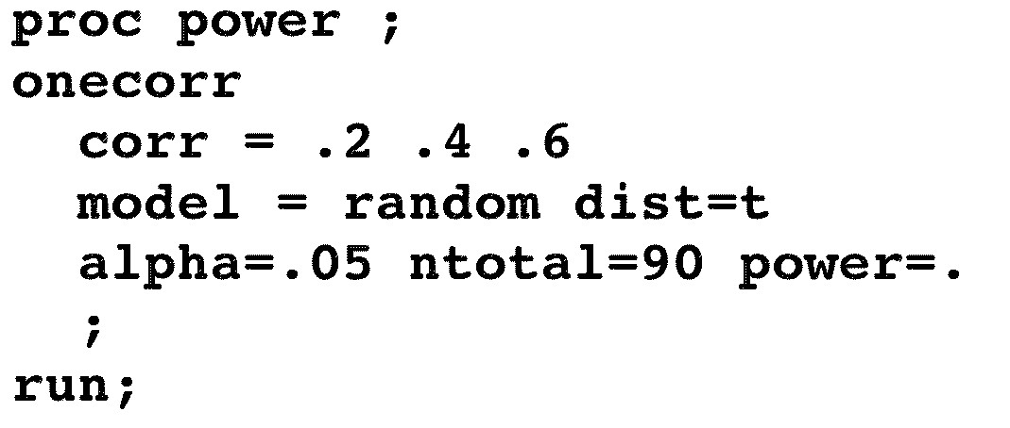
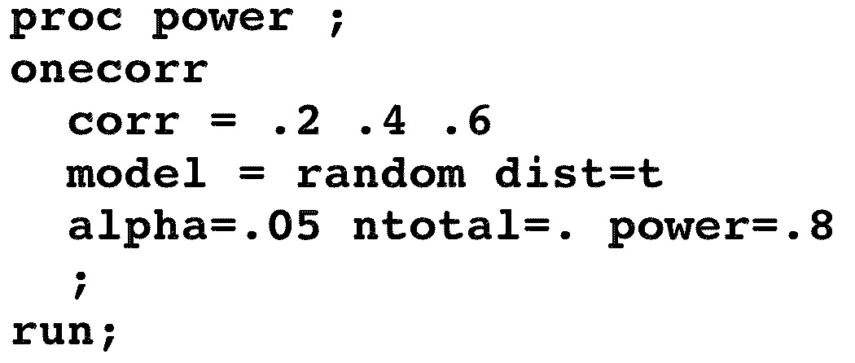
SAS Code for Estimating Power vs. Estimating N

Slide 9
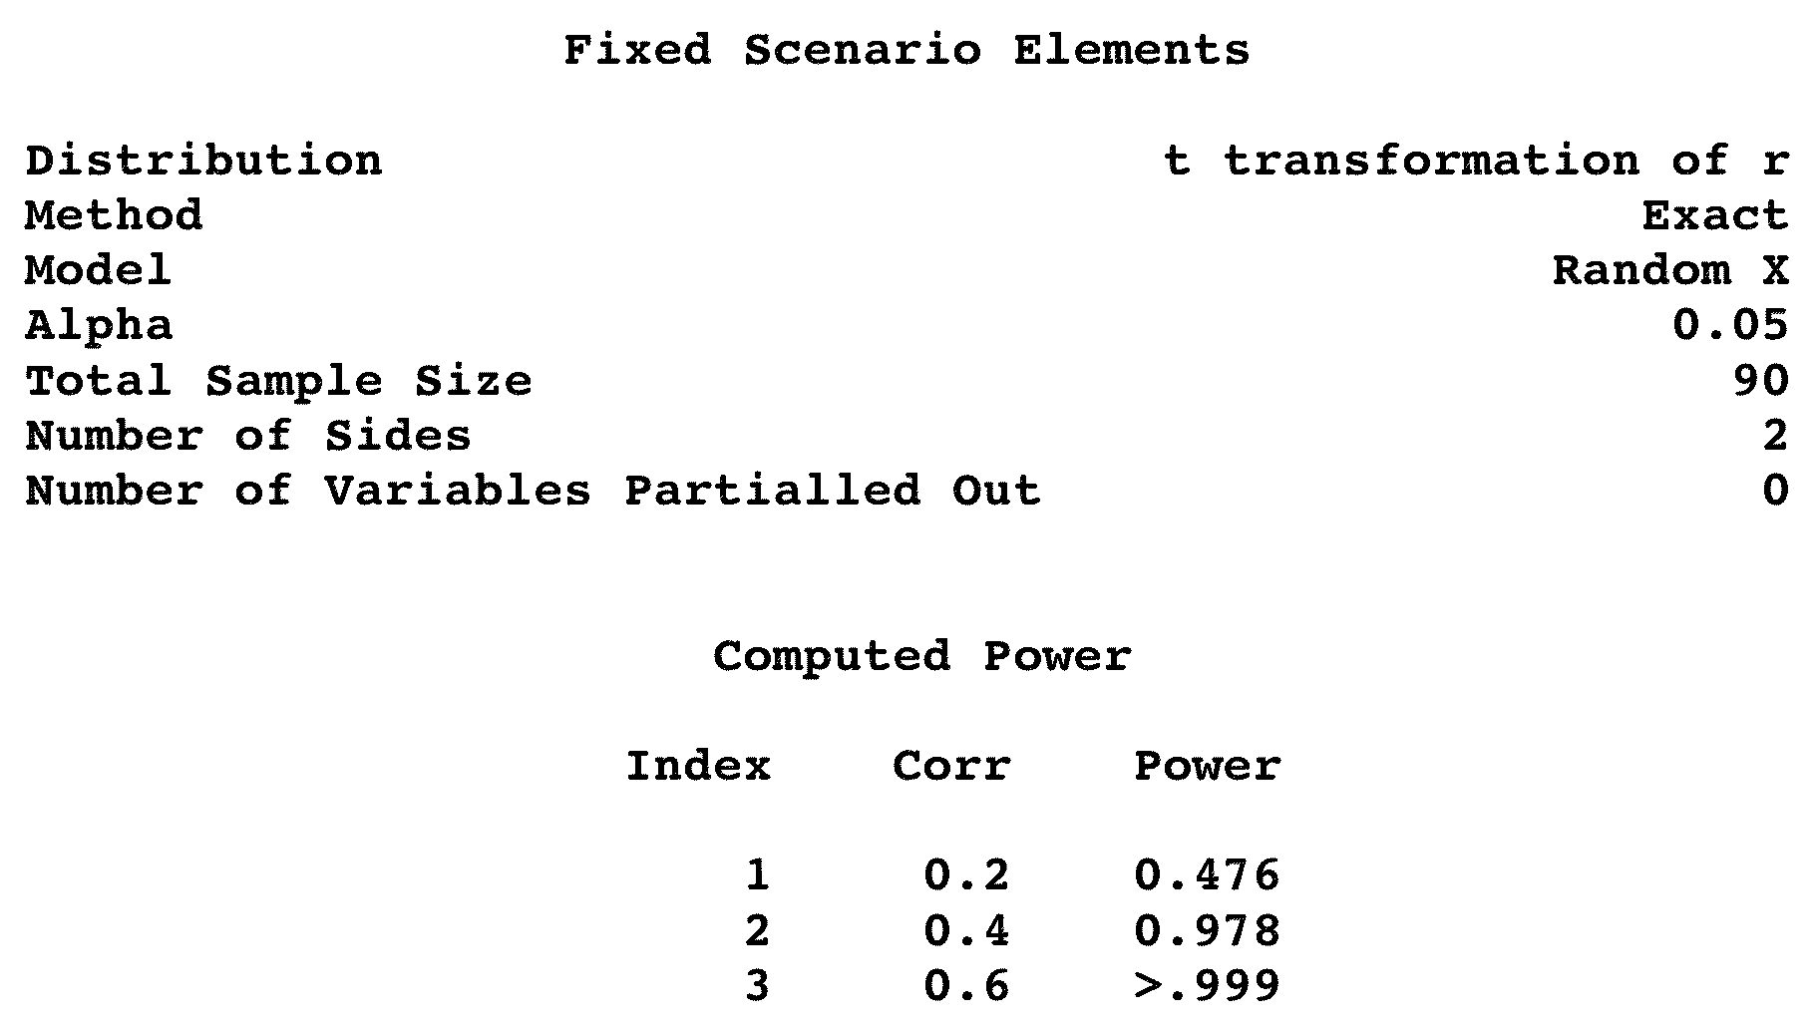
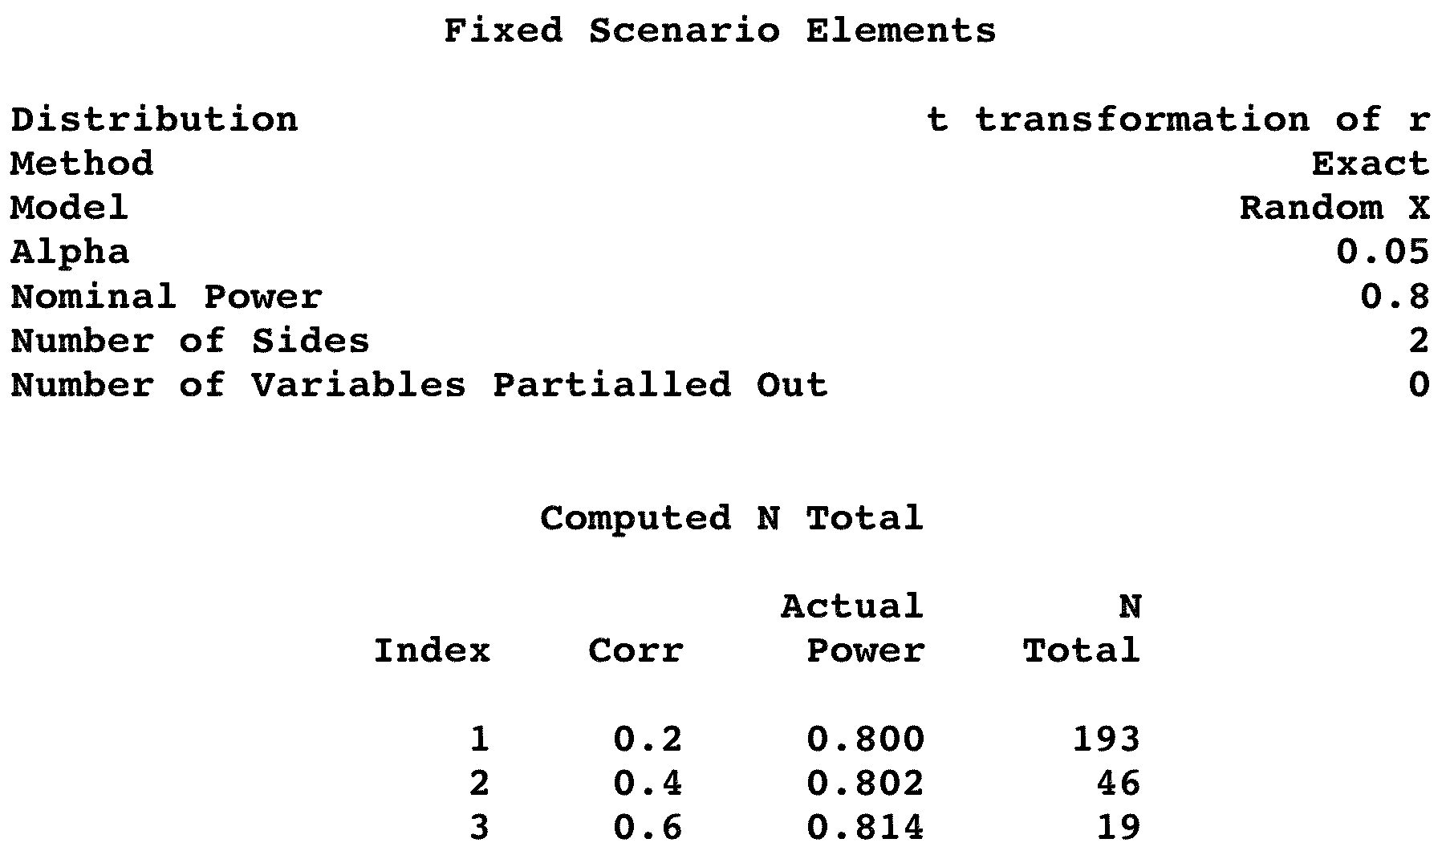
PROC POWER Results

Slide 10
Getting Nice Graphs
PLOT statement:
Specify the factor to put on the X axis
Other options (notably interpol = join to get connected lines)
Put at the end of your analysis
ODS graphics (ODS = Output Delivery System)
Easier to export graphs
Graphs come out as .png files

Slide 11
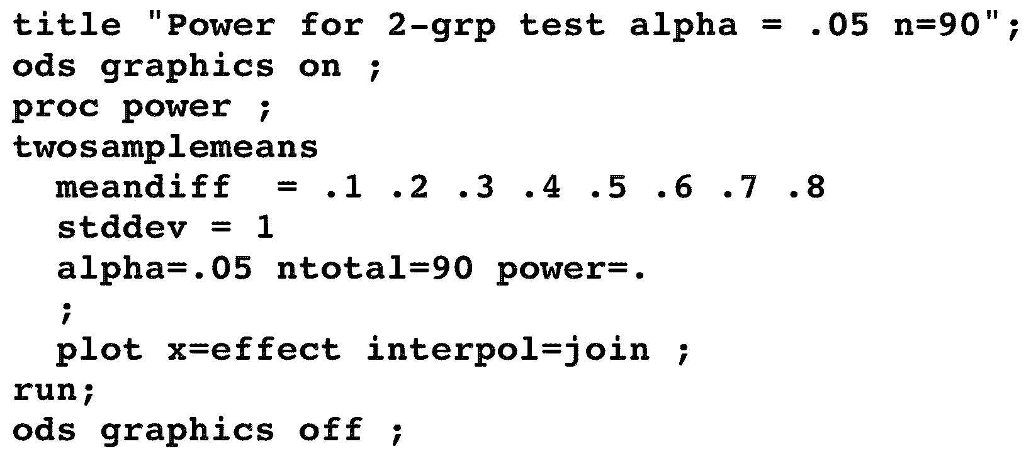
Code for a Simple Power Graph

Slide 12
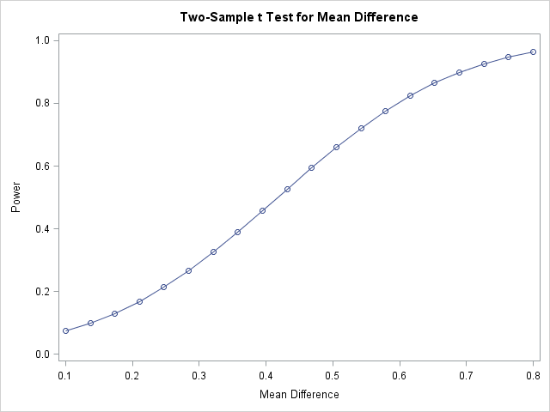
Simple Power Graph

Slide 13
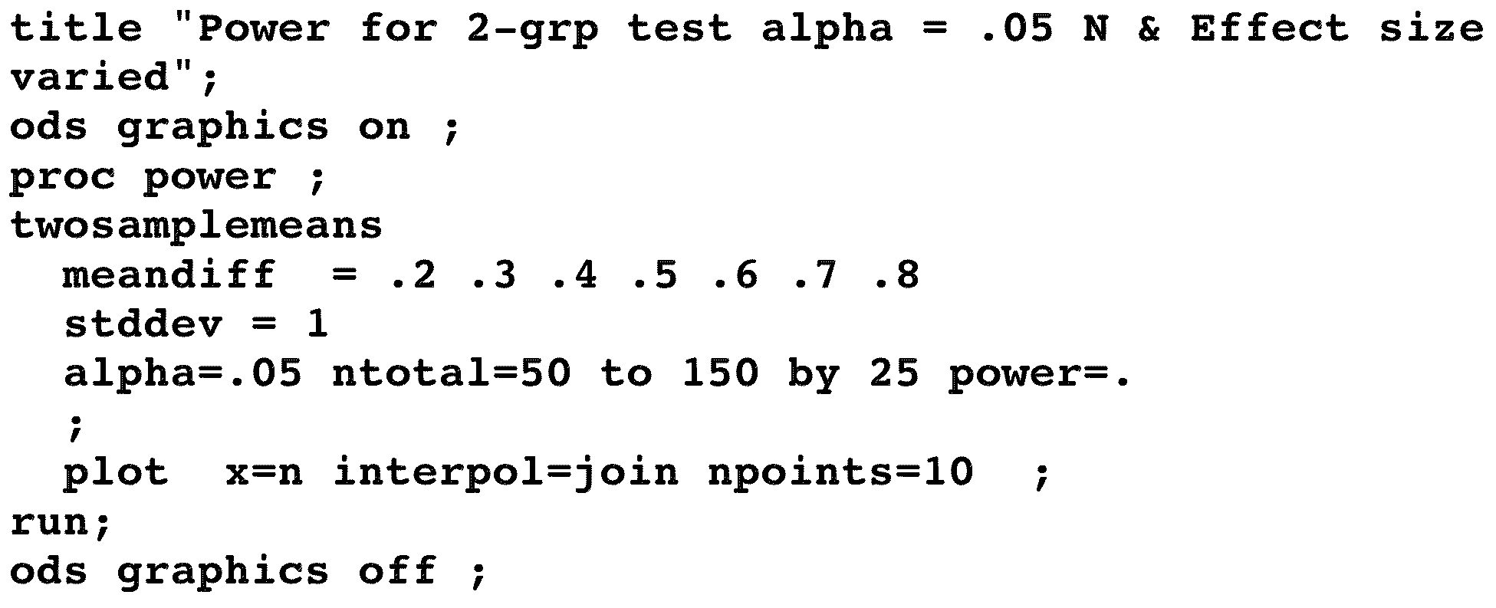
SAS Code for Fancier Graph

Slide 14
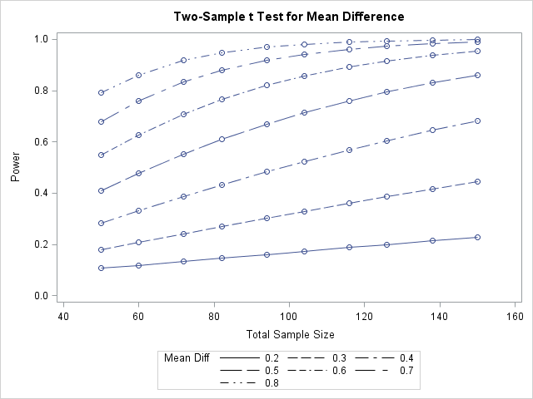
Fancier Power Graph

Slide 15
Demonstration

Slide 16
Limitations of Power Software
Repeated measures rarely considered
Hierarchical models are especially rare
Nested models ditto
Missing data rarely considered
Non-normal distributions are problematic
Two-part (zero-inflated) models are not considered
How effect sizes may vary over time is rarely discussed

Slide 17
Simulation
All the limitations of canned power programs can be overcome using simulation
Can run the full actual analysis you plan
Can use real data (i.e., not just nice random numbers)
Any number/spacing of time points
The Catch: LOTS of work
Must know/propose values for potentially hundreds of parameters
Ideally would involve many sensitivity analyses
But we have too many failed trials . . .
MPlus offers simulation of complex designs
Mathematical modeling is the ultimate answer

Slide 18
Final Thoughts
When you write a grant, you are asking society to buy information from you
Society sets low alpha levels to protect itself from incorrect positive (possibly biased) findings
Society limits power as a compromise
Wants assurance that useful new treatments have a reasonable chance of being detected
Does not want to waste too many $ on any one idea
Realistic power analyses are in everyone’s best interest, but are too costly for most studies

